Slide 1
A One Health Approach
By team: Byte Me
Madhyapur Thimi, Nepal

Slide 2
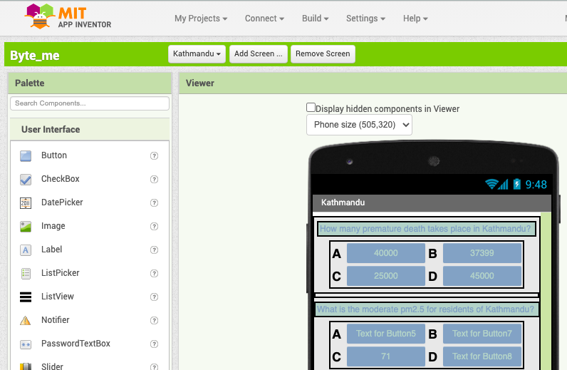
About the app
We used MIT App Inventor to make our app. It is an open-source software and it’s free. The app has been designed as a quiz so that people can have fun while learning about the global issue of Air Pollution.
Link: http://appinventor.mit.edu/

Slide 3
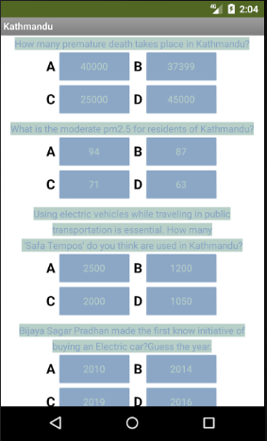
About our Solution
We came up with an idea of adding a little hint of a game in our educational app. Our solution consists of a city-wise separated information on Air Pollution and how it is affecting us. For the time being, we have put three main cities of Nepal.
We have engraved some actual solution for the degrading factors that causes air pollution too. Hence our app has informations for awareness as well as some solutions.

Slide 4
About the data
Our team has used open source data provided by NASA and its collaborators- CSA, ESA, CNEX, JAXA. The virtual bootcamps provided in youtube as well as the local virtual bootcamp were motivational.
Sources:
-https://thehimalayantimes.com/world/10-facts-about-air-pollution-on-world-environment-day/
-https://www.hindawi.com/journals/jeph/2018/1504591/
-https://kathmandupost.com/37/2019/10/26/electric-vehicles-are-the-future-of-mobility-but-is-nepal-ready
-https://appliedsciences.nasa.gov/what-we-do/health-air-quality
-https://so2.gsfc.nasa.gov/no2/pix/htmls/Kathmandu_data.html
-QGIS- an open source geographical information system.
-http://library.nhrc.gov.np:8080/nhrc/bitstream/handle/123456789/788/Situation%20analysis%20of%20ambient%20air%20pollution%20and%20respiratory%20health%20effects%20in%20Kathmandu%20valley.pdf?sequence=1
-

Slide 5
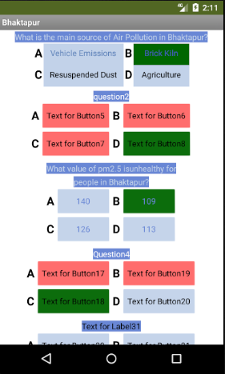
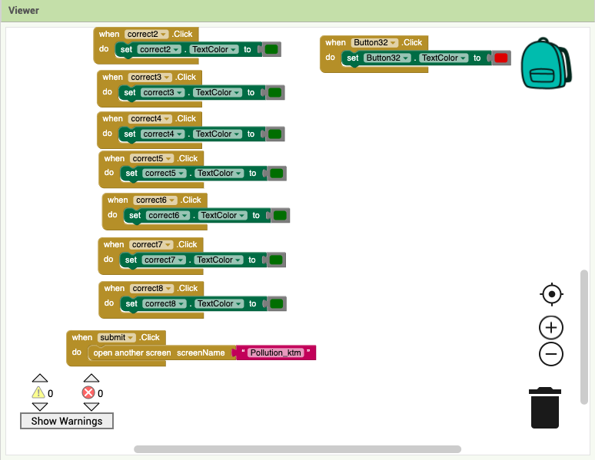
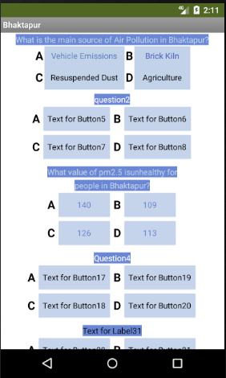
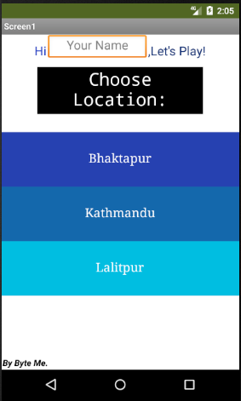
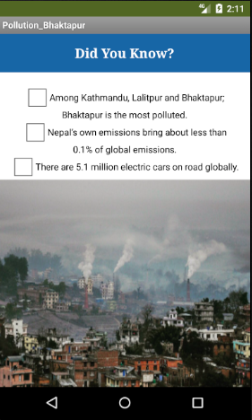
Glimpse of our App while making:

Slide 6
Work done by team
Nimika Pokhrel: Data Collection
Kritika Kharel: Data Collection
Riya Bazgain: App design
Sangam Rimal: Helped extract data

Slide 7
THANK YOU!!!

